Slide 1
Exception Handling

Slide 2
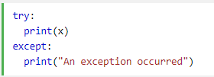
Exception Handling
When an error occurs, or exception as we call it, Python will normally stop and generate an error message.
The try block lets you test a block of code for errors.
The except block lets you handle the error.
The finally block lets you execute code, regardless of the result of the try- and except blocks.
These exceptions can be handled using the try statement:

Slide 3
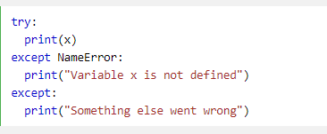
Many Exceptions
You can define as many exception blocks as you want, e.g. if you want to execute a special block of code for a special kind of error:

Slide 4
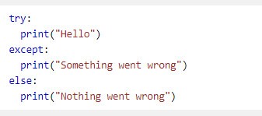
Else
You can use the else keyword to define a block of code to be executed if no errors were raised:

Slide 5
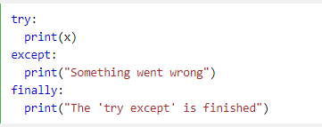
Finally
The finally block, if specified, will be executed regardless if the try block raises an error or not.

Slide 6

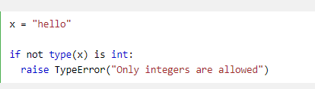
Raise an exception
As a Python developer you can choose to throw an exception if a condition occurs.
To throw (or raise) an exception, use the raise keyword.
The raise keyword is used to raise an exception.
You can define what kind of error to raise, and the text to print to the user.

